Slide 1
Biodegradation and Bioremediation
Learning Objectives
Recognize common aerobic and anaerobic biodegradation pathways for different chemical classes
Aromatics & alkanes
Organohalides (chloro- and flouro- organics) (e.g. TCE, PCBs, chlorobenzenes)
Polymers
Metals/radionuclides
Discuss reasons for a delay between a microbial communities’ exposure to a toxic chemical and observable compound biodegradation (=Acclimation period)
Discuss the general steps in site remediation at a particular contaminated site
Remedial characterization /Feasibility study
Selection of strategy (=Record of Decision)
Implementation and monitoring (Remedial Design/Remedial Action)
Closure of site
Describe the difference between in situ and ex situ bioremediation
Explain the differences between the following regarding in situ bioremediation: natural attenuation, and two types of enhanced bioremediation (biostimulation and bioaugmentation).
List the three overlapping lines of evidence required to document that in situ bioremediation is occurring at a site. Be able to describe some modern tools to provide this evidence

Slide 2
Bioremediation/Biodegradation
Prediction of degradation based on chemical structure
Acclimation
Types of biodeg:
Pollution prevention (reactors treating industrial waste)
Bioremediation of contaminated soils
Site remediation
Site characterization
Selection of strategy
Implementation and monitoring
Closure of site

Slide 3
Organic functional groups that undergo biotransformations
Some common industrial chemicals/pharmaceuticals
Which functional groups can you identify?

Slide 4
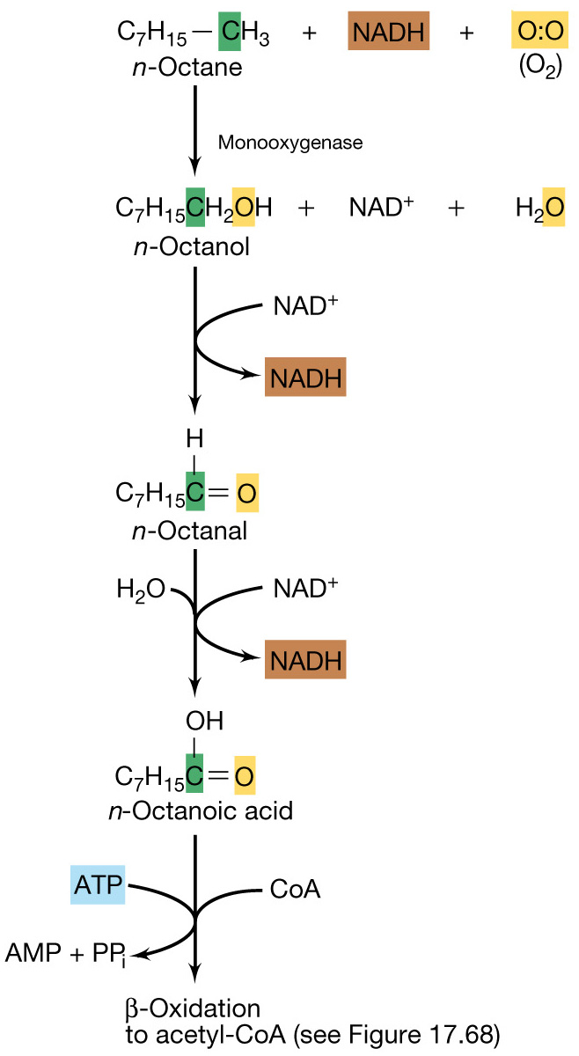
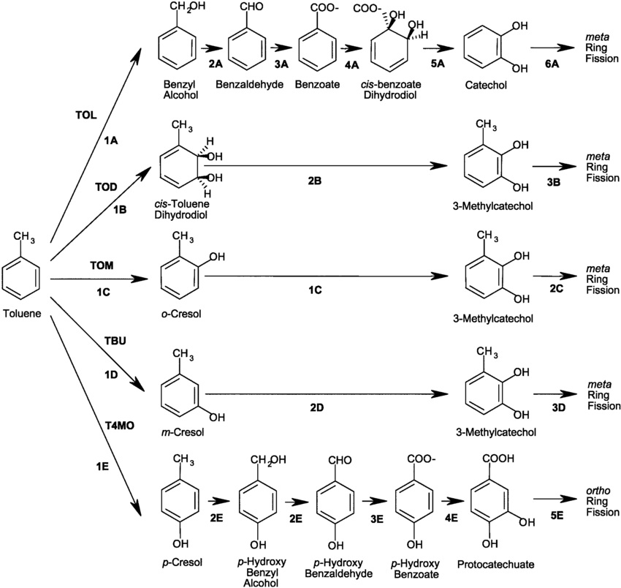
Aromatics and alkanes/alkenes
Hydrocarbon oxidation

Slide 5
Chloroorganics’ biodegradation

Slide 7
Other classes of contaminants
Polymers
Metals

Slide 8
Acclimation: why is there usually a lag before contaminant biodegradation?

Slide 9
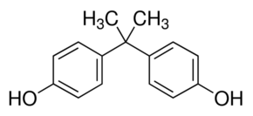
New strategy to support removal of emerging contaminants in wastewater
Constant low level inoculation of bacterial cultures that degrade contaminants
Since contaminants may enter the WW plant only occasionally or at widely varying concentrations over time, the “activated sludge” might not have the right biodeg’ve enzymes at high enough levels
Bisphenol A (BPA)

Slide 10
Aquifer remediation

Slide 11
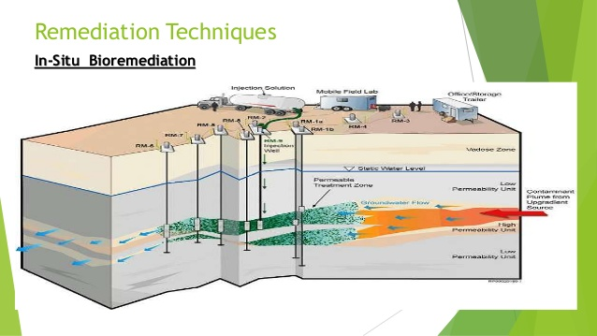
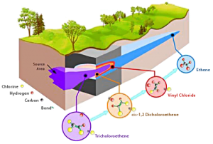
http://followgreenliving.com
http://www.slideshare.net/mohitishere/groundwater-contamination-and-prevention

Slide 12
Site Remediation steps
Site Characterization then

Slide 13
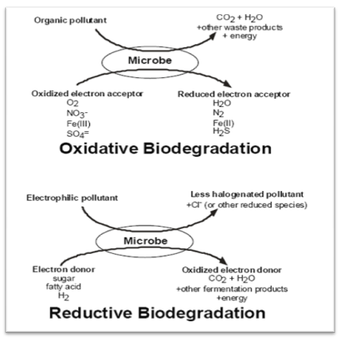
Groundwater bioremediation
Plume enhancements: inject limiting nutrients

Slide 15
Examples for Encouraging aerobic biodegradation
Bioventing in vadose zone
Biosparging in saturated zone

Slide 16
Passive treatment of leading edge of plume:
Biobarriers

Slide 17
Monitoring of bioremediation
Need to show evidence that in situ bioremediation is successful

Slide 18
Evidence for in situ bioremediation: The 3 Criteria (from the US National Research Council)
Contaminant(s) concentration is decreasing
Microorganisms (MOs) from the site are capable of catalyzing the biodegradation of the contaminant(s)
The biodegradative capability of the MOs is being realized under field conditions.

Slide 19
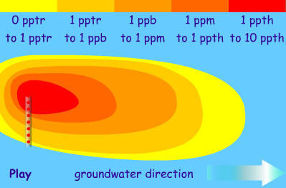
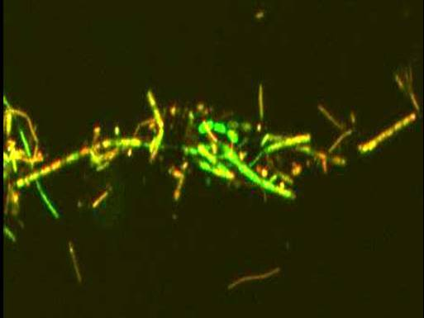
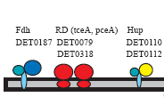
Biomarkers of chlorinated solvent bioremediation: monitoring activities of tiny creatures, deep underground
DNA (genes)

Slide 20
Example case study: passive bioremediation of TCE plume in groundwater

Slide 21
The Good: Chlorinated solvent bioremediation using mulch biobarriers

Slide 22
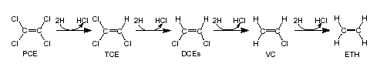
PCE and TCE contamination of GW
PCE (tetrachloroethene) and TCE (trichloroethene) are chlorinated solvents used as dry cleaning fluids, engine degreasers, and electronics cleansers
Very common pollutants: Tetrachloroethylene (PCE) has been found in at least 771 of the 1,430 National Priorities List (Superfund) sites identified by the Environmental Protection Agency (EPA) . (epa.gov)
Bioremediation (usually anaerobic) can be:
Ex situ (pump and treat)
Passive in situ – e.g. Monitored Natural Attenuation
Enhanced in situ – e.g. biostimulation (adding electron donor) or bioaugmentation (adding bacteria)
TCE plume in groundwater
http://followgreenliving.com

Slide 23

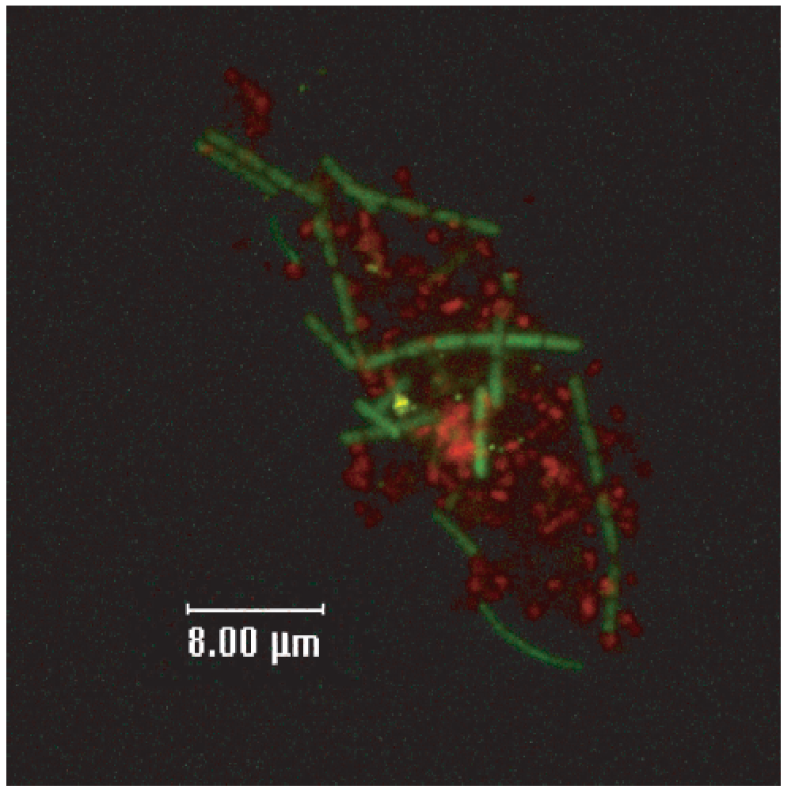
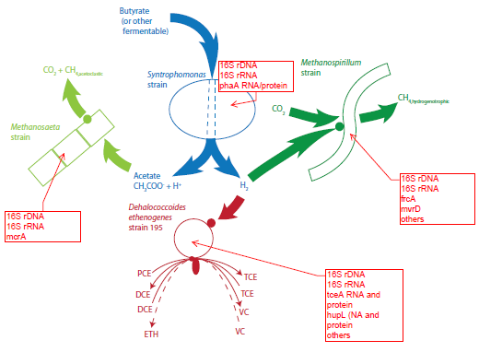
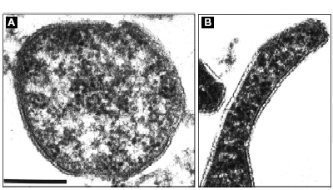
Dehalococcoides mccartyi (DMC) strain 195: First isolate to dechlorinate PCE to ethene (Cornell: Profs Gossett & Zinder)
DMC
Other genera
DMC
Other genera
DMC only
DMC only
Requires H₂ and organohalides to breathe (Organohalide respiring bacteria OHRB)
Very “ancient” bacteria group (Chloroflexi phylum). Natural anaerobic soil/sediment dwellers. Small genomes (1.5 MBps)
Grows better in complex microbial enrichment cultures than in pure culture.
Can use many different organohalides (PCBs, dioxins, chlorinated ethenes, others)
Microscopic observation of different types of microbes in lab bioreactors
0.2 μm
(from Maymo-Gatell et al., 1997, Science)

Slide 24
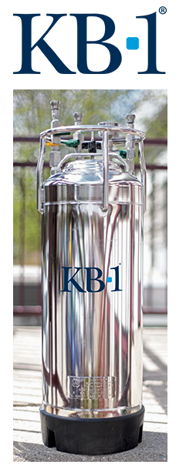

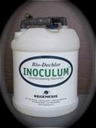
Bioaugmentation Culture: Add to your plume to speed up Bioremediation rates
Contain different strains of Dehalococcoides
Complete dechlorination of chlorinated ethenes
All also contain other types of microbes (fermenters, methanogens)
http://followgreenliving.com
http://web.utk.edu/~microlab/LoefflerLab/Bioremediation.html
Notes:
Approved for use in us, canada, several countries in europe, australia…
Have a low pH option
Interesting example of how there has been a lot of basic research, on these pathways, these reductive dehalogenases, and now a product is available that has been okayed for actual admission into the subsurface at contaminated sites.
If it works, how to track it’s working (for instance with biomarker), no pathogens (they certify that) not going to take over (***not a very versatile organism… so easier to get allowance to inject it. )

Slide 25
Cornell has its own Hazardous waste site (by airport).
Current remediation approach: pump and treat by sorption to activated carbon and disposal of spent activated carbon
Question: could in situ bioremediation be used instead?
TCE is the contaminant of concern (~0.1-1 mg/L concentration)
Slow groundwater movement (0.5 ft/day)
Plume is aerobic (based on GW samples extracted through monitoring wells)
We did treatability studies with site groundwater and different electron donors to stimulate anaerobic TCE remediation:
molasses, veggie oil, whey, mulch and compost
With native microbes versus with bioaugmentation with organohalide respiring bacteria (OHRB)

Slide 26
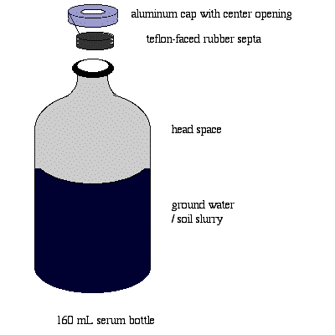
Treatability studies in microcosms
Flush bottle with nitrogen gas (eliminate oxygen)
Add GW (100 mL)
Add electron donor
Add additional TCE
In half bottles add bioaugmentation culture
“Serum” bottle with crimp cap

Slide 27
Vegetable Oil
Total umoles
Time (days)

Slide 28
Molasses
w/KB1 inoculum
w/just native GW bacteria
Total umoles
Time (days)

Slide 29
Mulch
w/KB1 inoculum
w/just native GW bacteria
Total umoles
Time (days)

Slide 30
No Donor
w/KB1 inoculum
w/just native GW bacteria
Total umoles
Time (days)

Slide 31
Liquid Electron Donors (e.g. whey, molasses) can be injected into plume Solid substrate EDs (like Mulch or compost) can be used in biobarriers

Slide 32
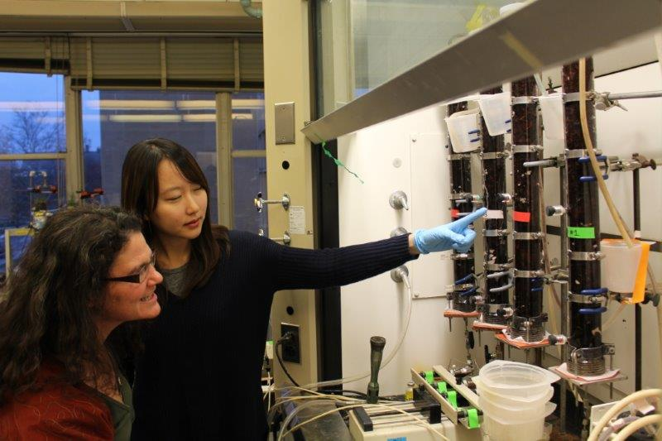
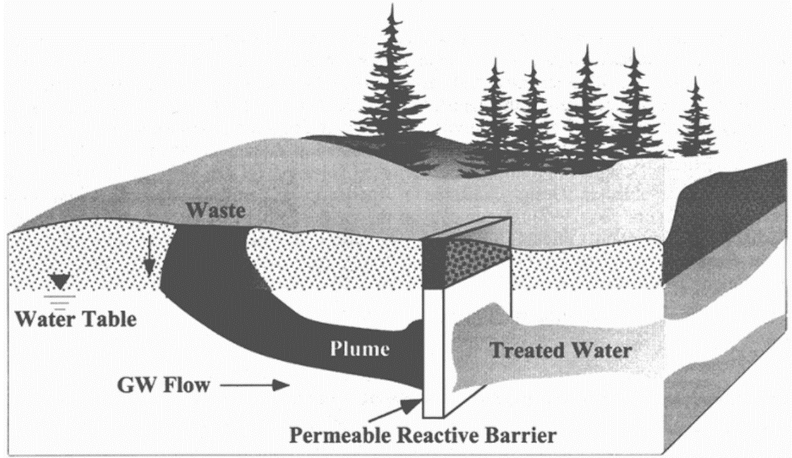


TCE Bioremediation via mulch biobarriers
(a type of permeable reactive barrier)

Slide 33
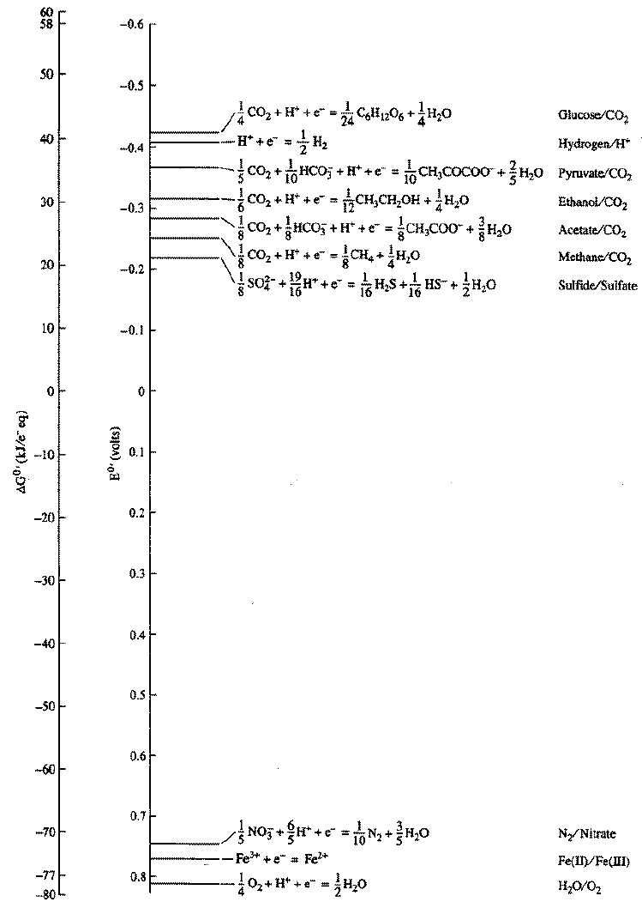
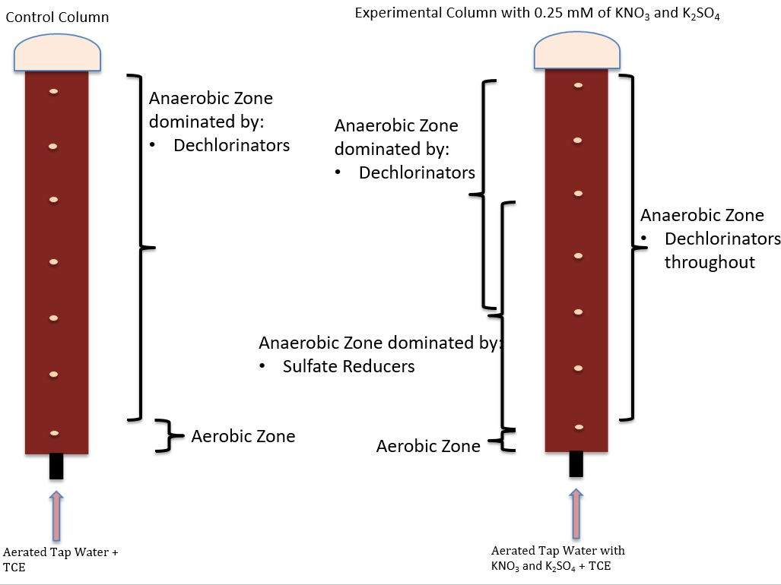
Presence of dissolved oxygen could impact performance
Oxygen can be at high levels in shallow aerobic groundwaters
O2 is Toxic to OHRB (which are strict anaerobes)
Theoretically O₂ would be consumed early in the biobarrier (energetically favored)
This might leave a large anaerobic region for dechlorination (“OHR”) to bioremediate TCE

Slide 34
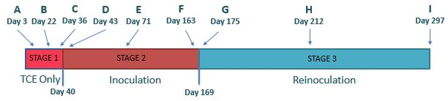
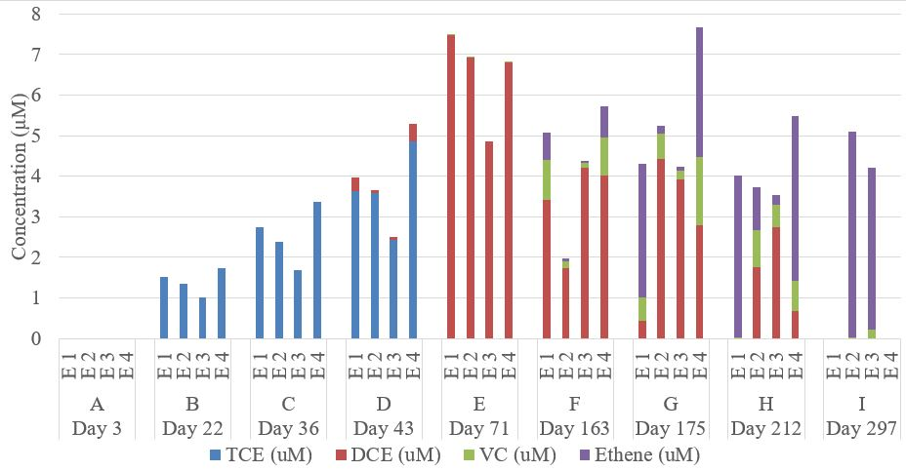
Q: Can a mulch biobarrier treat 1 mg/L TCE in aerobic groundwater?
Keep column features:
60 cm long
3 day hydraulic residence time
mulch mixed with 20% limestone chips by weight
pumped aerobic water with TCE Inoculated with KB-1 (1:1000 dilution) (twice; on day 40 & 170)
Port 5 porewater

Slide 35
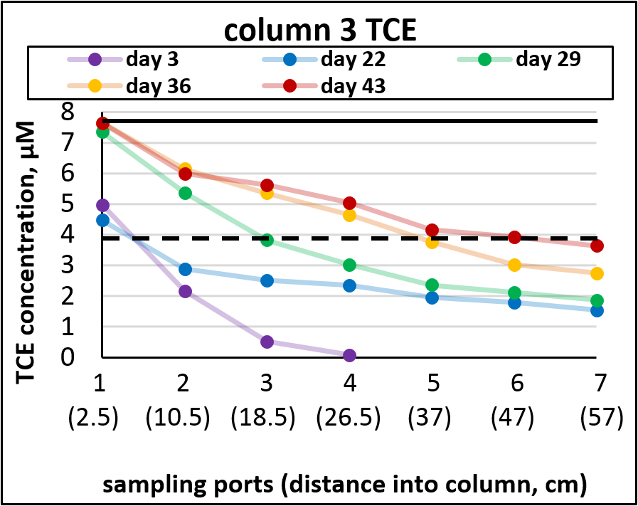
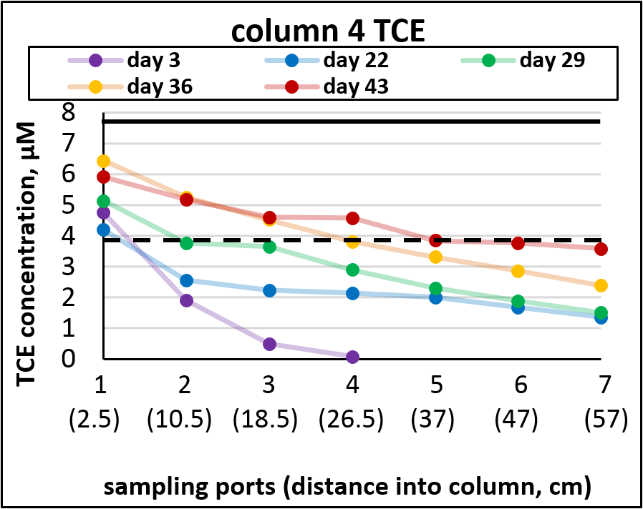
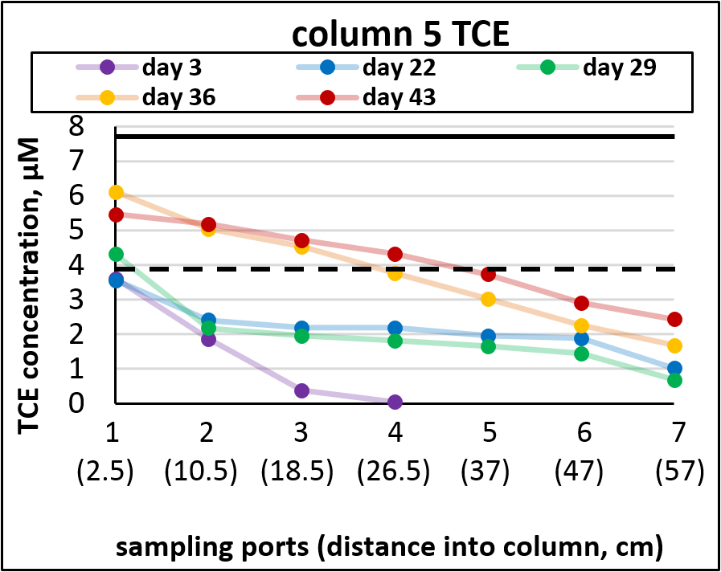
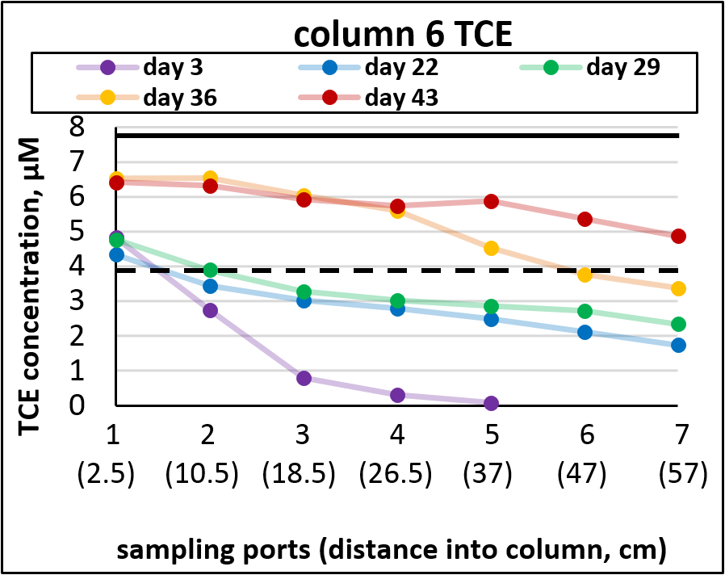
a
E1
b
E2
c
E3
d
E4

Slide 36
Q: Can a mulch biobarrier treat 1 mg/L TCE in aerobic groundwater?
Keep column features:
60 cm long
3 day hydraulic residence time
mulch mixed with 20% limestone chips by weight
pumped aerobic water with TCE Inoculated with KB-1 (1:1000 dilution) (twice; on day 40 & 170)
Port 5 porewater

Slide 37
Q: Can a mulch biobarrier treat 1 mg/L TCE in aerobic groundwater?
Keep column features:
60 cm long
3 day hydraulic residence time
mulch mixed with 20% limestone chips by weight
pumped aerobic water with TCE Inoculated with KB-1 (1:1000 dilution) (twice; on day 40 & 170)
Port 5 porewater

Slide 38
Q: Can a mulch biobarrier treat 1 mg/L TCE in aerobic groundwater?
Keep column features:
60 cm long
3 day hydraulic residence time
mulch mixed with 20% limestone chips by weight
pumped aerobic water with TCE Inoculated with KB-1 (1:1000 dilution) (twice; on day 40 & 170)
Port 5 porewater

Slide 40
Q: Can a mulch biobarrier treat 1 mg/L TCE in aerobic groundwater?
Conclusions:
Full dechlorination is possible.
Oxygen used up by first port (2.5 cm into column)
Mulch should last ~ 7years before recharge needed
New Questions
Could a higher inoculum dose reduce startup time to full dechlorination?
What if other alternative electron acceptors are present? (nitrate, sulfate)
Keep column features:
60 cm long
3 day hydraulic residence time
mulch mixed with 20% limestone chips by weight
pumped aerobic water with TCE Inoculated with KB-1 (1:1000 dilution) (twice; on day 40 & 170)
Port 5 porewater

Slide 41
We would expect a redox cascade to form in column
Anaerobic zone
-dechlorination
-sulfate reduction
-methanogenesis
Denitrification zone
Aerobic zone

Slide 42
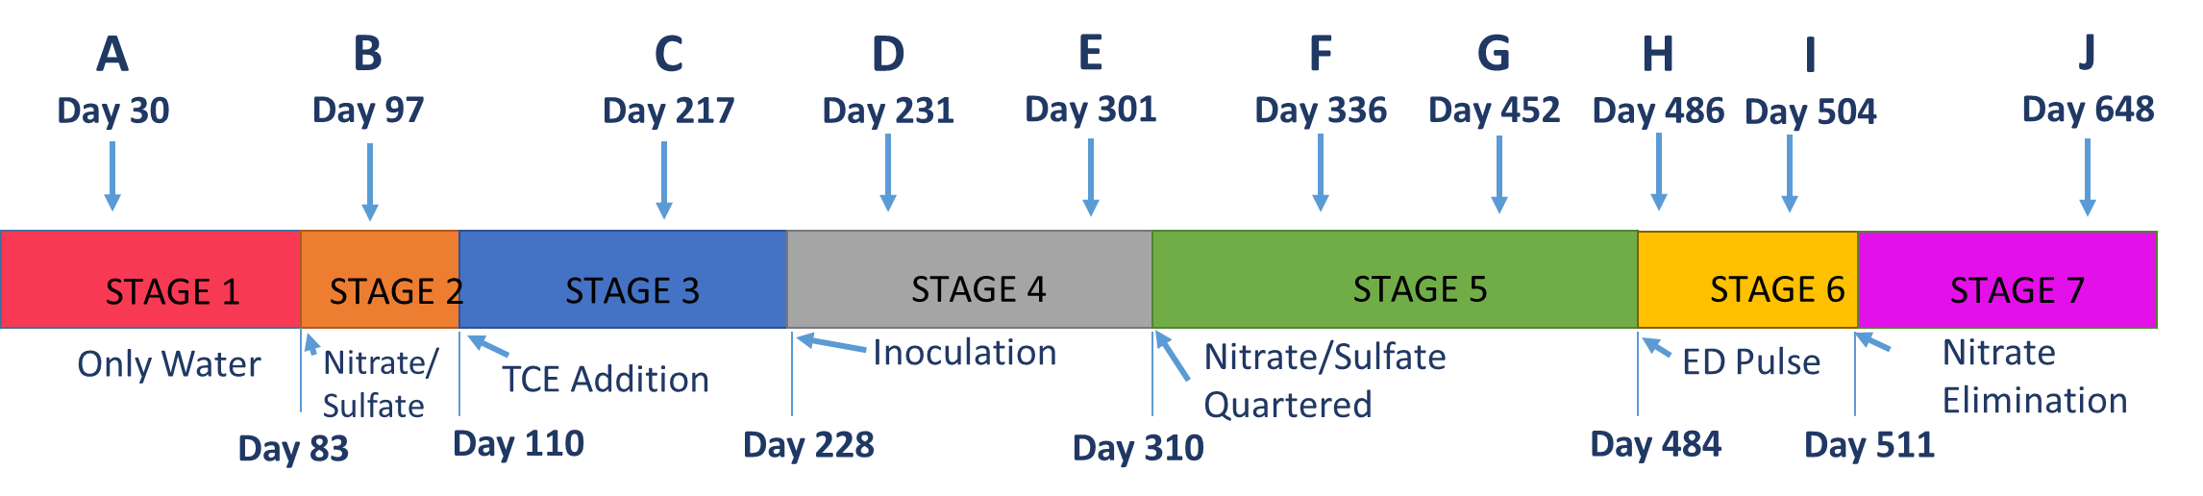
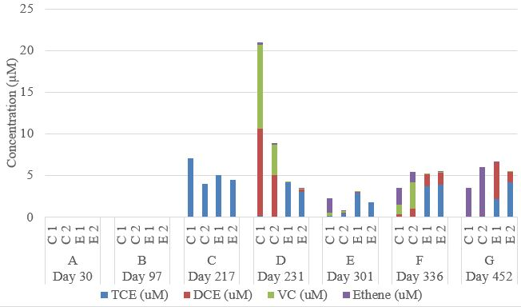
Anaerobic zone
-dechlorination
-sulfate reduction
-methanogenesis
Denitrification zone
Aerobic zone

Slide 43
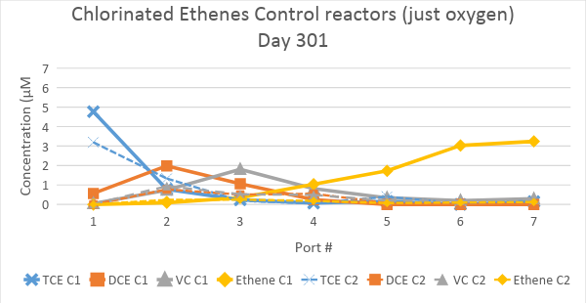
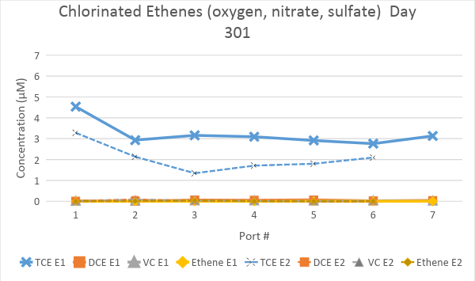
O2-only columns fully removing TCE, but not the Nitrate & Sulfate receiving columns
(a)

Slide 44
Nitrate levels over port location and with time
(a)
(b)
Notes:
Add the data from the point after quartering Nitrate & sulfate. Edit caption accordingly (replace XXX & XX )
Actually I would delete Day 217 – that data is the outlier from trends for both E1 & E2. So just replace Day 217 with Day XXX (after quartering).

Slide 45
Anaerobic zone
-dechlorination
-sulfate reduction
-methanogenesis
Denitrification zone
Aerobic zone

Slide 46
Summary of findings
Lab-scale mulch biobarriers inoculated with KB-1TM accomplished complete dechlorination of 1 mg/L TCE in aerobic water
Oxygen was consumed rapidly in the mulch flow-through column, leaving the majority of the columns to support the activity of dechlorinators.
Mulch inoculation was required and higher inoculation levels (1:100 versus 1:500) shortened the time to complete dechlorination.
Nitrate presence as low as 0.25 mM did preclude dechlorination even when columns were inoculated at 1:100 dilution. Some nitrate penetrated the mulch column completely.
Perhaps TCE inhibiting/toxic to denitrifiers?
Nitrate elimination improved the dechlorinating performance and suggested that dechlorinating bacteria remained viable in the column for more than 1.5 years.

Slide 47
DNA methods show that most of the Dehalococcoides are attached to the mulch biofilm (not in suspension, aka “planktonic”)
Gene copies per mL column volume

Slide 48
Evidence for in situ bioremediation: The 3 Criteria (from the US National Research Council)
Contaminant(s) concentration is decreasing
Microorganisms (MOs) from the site are capable of catalyzing the biodegradation of the contaminant(s)
The biodegradative capability of the MOs is being realized under field conditions.

Slide 49
Biomarkers of chlorinated solvent bioremediation: monitoring activities of tiny creatures, deep underground
DNA (genes)

Slide 50
Biodegradation and Bioremediation
Learning Objectives
Recognize common aerobic and anaerobic biodegradation pathways for different chemical classes
Aromatics & alkanes
Organohalides (chloro- and flouro- organics) (e.g. TCE, PCBs, chlorobenzenes)
Polymers
Metals/radionuclides
Discuss reasons for a delay between a microbial communities’ exposure to a toxic chemical and observable compound biodegradation (=Acclimation period)
Discuss the general steps in site remediation at a particular contaminated site
Remedial characterization /Feasibility study
Selection of strategy (=Record of Decision)
Implementation and monitoring (Remedial Design/Remedial Action)
Closure of site
Describe the difference between in situ and ex situ bioremediation
Explain the differences between the following regarding in situ bioremediation: natural attenuation, and two types of enhanced bioremediation (biostimulation and bioaugmentation).
List the three overlapping lines of evidence required to document that in situ bioremediation is occurring at a site. Be able to describe some modern tools to provide this evidence

